Slide 1
VNF
Virtualized Network Functions (VNFs)
VNF
VNF
CNF
CNF
Network Functions Virtualization Infrastructure (NFVI)
Virtualization Layer
Virtual Compute
Virtual Storage
Virtual Network
Hardware Resources
Compute
Storage
Network
Figure 4.1 – NFV and VNF layers

Slide 2
SDN
Application Layer
App 1
App 2
App 3
Northbound
Interface
Control Layer
SDN Controller
Southbound
Interface
Data Layer
Controller Agent
Controller Agent
Controller Agent
Data Plane
Data Plane
Data Plane
Network
Device
Network
Device
Network
Device
Figure 4.2 – SDN topology layers

Slide 3
NMS
Network Management System
Network
SNMP
SNMP
SNMP
Network Device
Network Device
Agent
Agent
Agent
Network Device
Figure 4.4 – Network management architecture

Slide 4


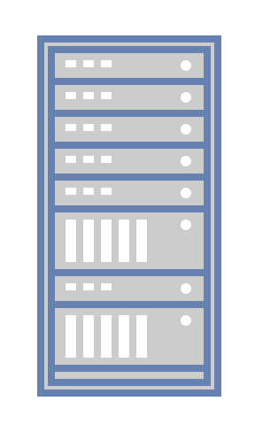

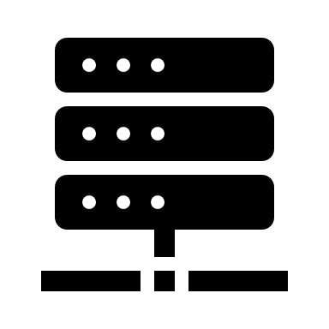
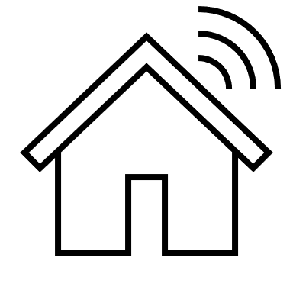


MEC
MEC
Server
Cloud
Gateway
Data
Core
Network
Figure 4.5 – MEC within the larger edge architecture

Slide 5


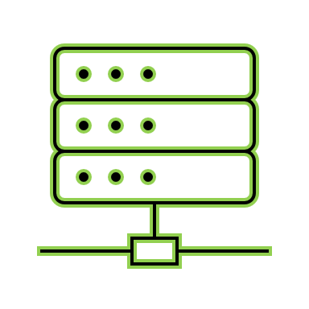




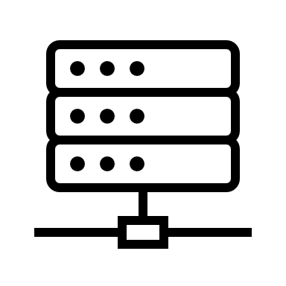



RAN
Open RAN
Openness
Virtual RAN
Legacy RAN
Hardware
Virtualization
Software
Figure 4.6 – Virtualization in a RAN

Slide 6
5G network
5G Network
RAN
Transport Network
Core Network
Figure 4.7 – 5G network components

Slide 7
CSP and Hyperscaler
Hyperscaler
1
CSP 1
Hyperscaler
2
CSP 2
Hyperscaler
3
CSP 3
Figure 4.8 – Hyperscaler-to-CSP relationship

Slide 8
Edge realms
End device
Enterprise
Access Point
Access Network
Transport
Core Network
Internet
Edge Computing
Telco Edge Computing
Multi-access Edge Computing (MEC) /
Network Edge
On-premises Edge Computing
Sensor, Actuator,
Robot, Drone
Server, Gateway
Customer premises equipment (CPE), Set top box (STB),
SIM
Micro cell, Macro cell, Telco cabinet
Central office
CDN, Central office
CDN, Data center
CDN, Internet exchange
Figure 4.9 – Various edge realms

